Slide 1
Leafly Cannabis Strain Data Analysis
Yash S
ALY6000
2024-10-13
Prof. Wilder
1

Slide 2
Table of Contents
I
Introduction
3
II
Key Findings
5
III
Conclusion & Discussions
11
IV
Reference
13
2
2

Slide 3

INTRODUCTION
The Leafly Cannabis Strain dataset contains over 4,700 records of cannabis strains, detailing their strain types, THC levels, common terpenes, and reported effects.
This analysis aims to identify key trends in cannabis strains, such as the distribution of strain types, average THC levels across types, and the prevalence of specific terpenes.
Important variables include strain type (Indica, Sativa, Hybrid), THC level (as a percentage), and the most common terpene associated with each strain.
3
2

Slide 4

INTRODUCTION
The goal is to explore how these factors vary across strains and determine potential relationships between strain characteristics and their effects.
"Steps taken to clean the dataset:
Removed rows with missing strain types.
Converted percentage values to numeric.
Dropped irrelevant columns like 'img_url'.
Ensured consistency in data types."
4
2

Slide 5


KEY FINDINGS
Summary of key variables:
THC Levels:
Min: 4%, Max: 34%
Median: 18%
Mean: 18.26%
Most common strain type: Hybrid
Prevalent terpenes: Limonene, Myrcene.
Notes Section: This slide presents the key summary statistics for THC levels across strains. The average THC level is approximately 18%, with Hybrid strains being the most common. A significant portion of the data contains missing values (1671), which should be accounted for in further analysis.
5
2

Slide 6
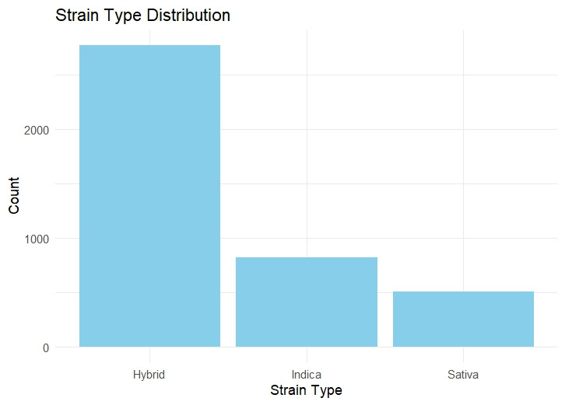
KEY FINDINGS
Bar Chart
The chart is titled "Strain Type Distribution." It shows the count of three different strain types: Hybrid, Indica, and Sativa.
Hybrid: This strain type has the highest count, exceeding 2000.
Indica: This one sits slightly above 1000.
Sativa: The lowest, with a count below 1000.
Notes Section: The bar chart shows the dominance of Hybrid strains in the dataset. This visualization helps highlight that more than 50% of the strains are Hybrids, with fewer Sativa and Indica strains. This distribution could be useful for understanding strain preferences and market demand.
6
2

Slide 7
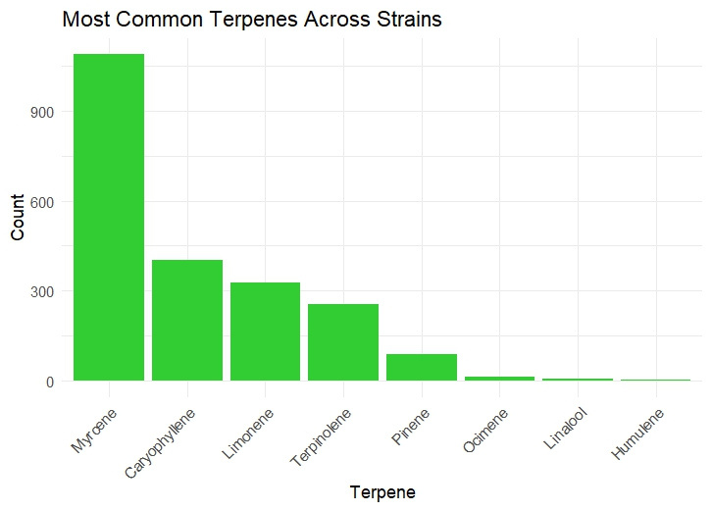
KEY FINDINGS
Bar Chart
The chart, titled "Most Common Terpenes Across Strains," illustrates the distribution of various terpenes found in different strains.
Key observations::
Myrcene: The most prevalent terpene, with a count exceeding 900.
Caryophyllene and Limonene: The next most common, with counts around 350 and 300, respectively.
Terpinolene: Slightly above 200 in count.
Pinene: Has a count below 100.
Ocimene, Linalool, and Humulene: Very low counts, close to zero.
In summary, Myrcene dominates the terpene landscape, followed by Caryophyllene and Limonene, with the rest trailing behind significantly. These trends offer insight into the chemical profiles of different strains, which can inform their potential effects and uses.
Notes Section: This visualization compares the THC levels across different strain types. Sativa strains tend to show slightly higher THC levels on average, while Indica and Hybrid strains are more evenly distributed. This provides insight into the potency variations across strain types.
7
2

Slide 8
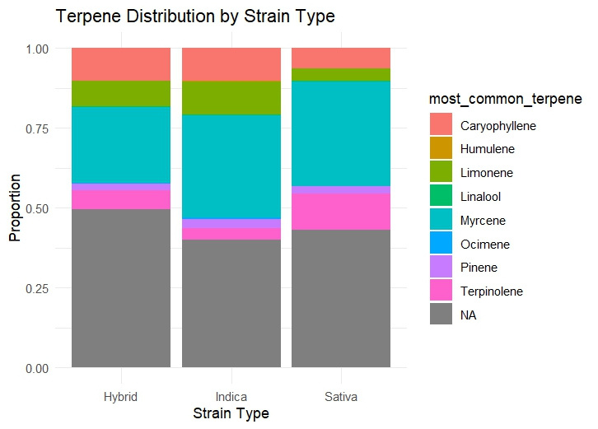
KEY FINDINGS
Bar Chart
The chart is titled "Terpene Distribution by Strain Type." It shows the proportion of different terpenes in three types of cannabis strains: Hybrid, Indica, and Sativa.
Key Observations:
Hybrid Strains:
Largest proportion is "NA" (gray), indicating unspecified terpenes. Myrcene (cyan) and Caryophyllene (red) are prominent. Smaller amounts of other terpenes.
Indica Strains:
Like Hybrid, "NA" (gray) is the largest. Myrcene (cyan) is the next most common. Caryophyllene (red) and Limonene (green) are also present.
Sativa Strains:
Again, "NA" (gray) dominates. Noticeable presence of Myrcene (cyan), Caryophyllene (red), and Limonene (green). Significant presence of Terpinolene (pink).
Notes Section: The bar chart highlights that terpenes like Myrcene and Limonene are the most frequently occurring in the dataset. These terpenes are known for their relaxing and energizing effects, respectively, which might explain their popularity across strains.
8
2

Slide 9
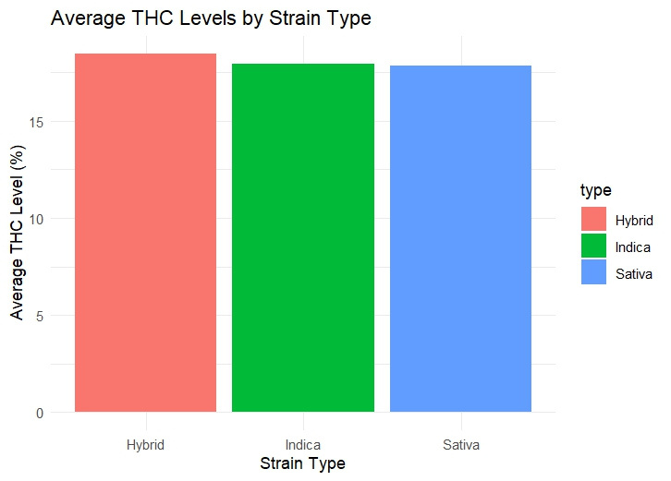
KEY FINDINGS
Bar Chart
The chart, titled "Average THC Levels by Strain Type," compares the average THC levels (percentage) across three types of cannabis strains: Hybrid, Indica, and Sativa.
Key Observations:
Hybrid Strains:
Represented by a red bar.
Average THC level: Approximately 17%.
Indica Strains:
Represented by a green bar.
Average THC level: Also around 17%.
Sativa Strains:
Represented by a blue bar.
Average THC level: Slightly lower at approximately 16%.
Notes Section: The chart compares average THC levels among Hybrid (17%), Indica (17%), and Sativa (16%) strains, indicating that Hybrid and Indica strains are similarly potent, while Sativa strains have slightly lower THC levels.
9
2

Slide 10
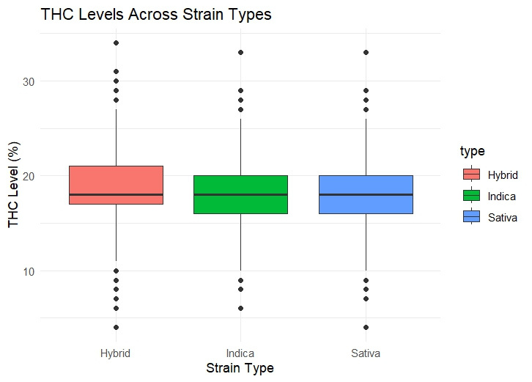
KEY FINDINGS
Box Plot
The chart displays the average THC levels by strain type, comparing Hybrid, Indica, and Sativa strains.
Observations:
Hybrid Strains (Red Bar): Average THC level is around 17%.
Indica Strains (Green Bar): Average THC level is also around 17%.
Sativa Strains (Blue Bar): Average THC level is slightly lower, about 16%.
Trends:
Consistency: Hybrid and Indica strains show similar average THC levels, both around 17%.
Slight Variation: Sativa strains have a marginally lower average THC level, around 16%.
Notes Section: The chart shows that Hybrid and Indica strains have similar average THC levels of around 17%, while Sativa strains have a slightly lower average THC level of approximately 16%.
10
2

Slide 11
CONCLUSION
"This analysis of the Leafly Cannabis Strain Dataset highlights significant trends in cannabis strains and their characteristics:
Hybrid and Indica Strains: Both types display similar average THC levels, averaging around 17%. This suggests that both strain types may offer comparable potency to consumers.
Sativa Strains: These strains have a slightly lower average THC level of approximately 16%, indicating potential differences in effects and consumer preferences.
Terpene Prevalence: Common terpenes like Myrcene and Limonene dominate the dataset, suggesting that these compounds may influence the aromatic and therapeutic qualities of the strains.
Missing Data: A considerable amount of data (1671 NA values for THC levels) could impact the analysis, emphasizing the importance of data quality in understanding strain effects."
11
2

Slide 12
CONCLUSION
Key Observations:
Strain Type Distribution: Hybrid strains are the most common in the dataset, potentially indicating a consumer preference for these strains.
THC Levels: Average THC levels are consistently high across Hybrid and Indica strains, while Sativa strains show slightly lower levels.
Terpene Analysis: The prevalence of certain terpenes may correlate with the reported effects of each strain, highlighting their role in consumer choice.
Data Quality: The significant amount of missing values in THC levels raises questions about data integrity and its implications for analysis.
Follow-Up Questions:
Effectiveness of Strains: How do different strain types perform in terms of therapeutic effects for specific medical conditions (e.g., anxiety, pain)?
Correlation with Effects: What is the relationship between the presence of specific terpenes and the effects reported by users?
Consumer Preferences: Are there trends in consumer preferences for certain strain types or THC levels over time?
Regional Differences: How do strain types and potency vary across different regions, and what factors influence these differences?
Long-Term Studies: How do consumer experiences and preferences evolve with the increasing availability of cannabis products?
12
2

Slide 13
REFERENCE
2022 April 24
"Kaggle. (2023). Leafly Cannabis Strain Data. https://www.kaggle.com/datasets/gthrosa/leafly-cannabis-strains-metadata"
13
2

